Slide 1
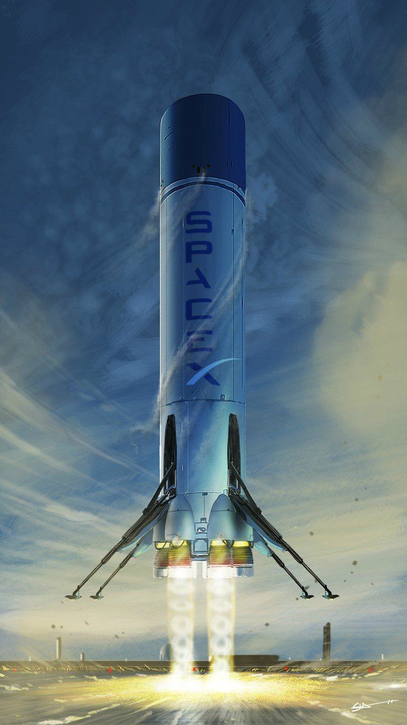
SpaceX “When something is important enough, you do it even if the odds are not in your favor.” Elon Musk
11Group
ارائه دهندگان : اعضای گروه: سوفیا رضاطبع - ناصرنوری مجتبی ایران مهر، مریم صبوری فرد، اسماعیل پروین،
ملیکا رضایت، محمد تهرانی، مهدی خامدا، بیتا آبیار

Slide 2
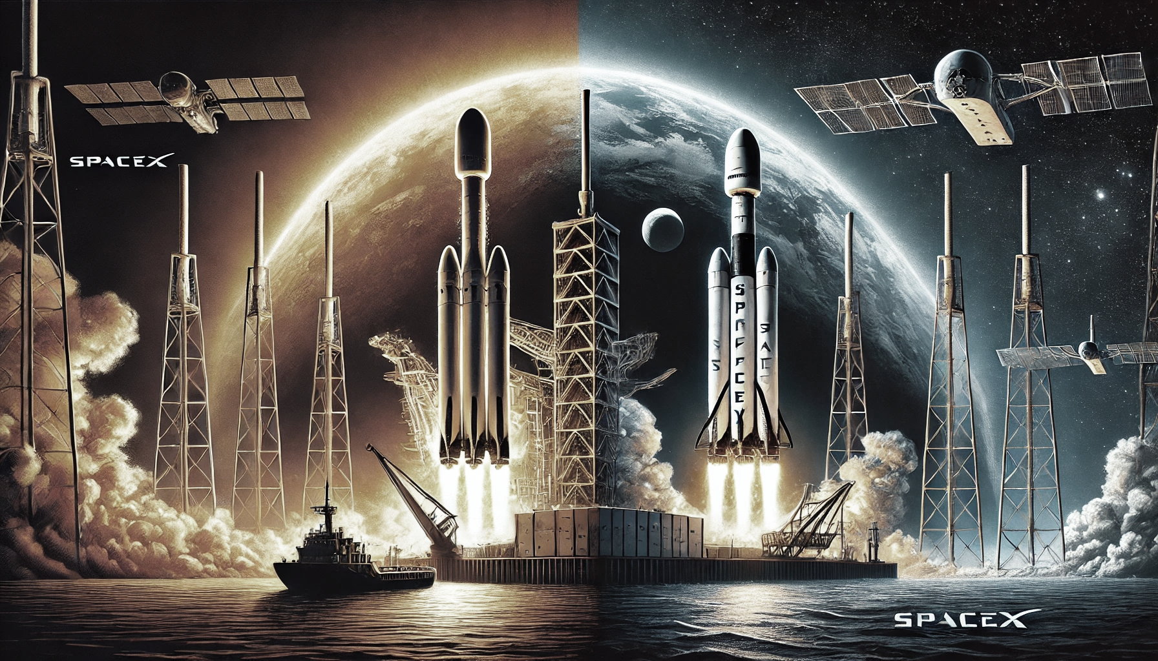
Introduction
Reusable Rockets: A Game Changer in Space Exploration
Traditional rockets like Soyuz and Saturn V are disposable, with stages burning up in the atmosphere.
This approach requires building new rockets for every mission, increasing costs significantly.
Falcon 9's key innovation: complete reusability, drastically reducing space travel costs.

Slide 3
Problem Statement
Predicting the Successful Landing of Falcon 9
The successful landing of Falcon 9 is a key factor in reducing space mission costs.
Predicting this landing requires detailed analysis of rocket launch data, environmental conditions, and the technical specifications of the rocket.
Objective: To design accurate predictive models based on real-world data to improve the safety and efficiency of space missions.

Slide 4
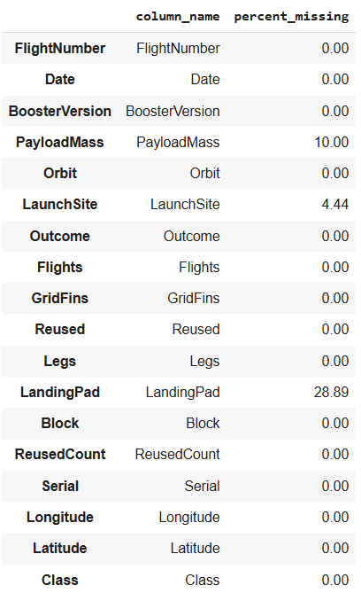
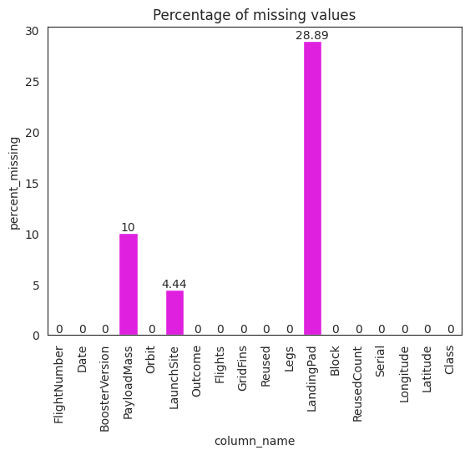
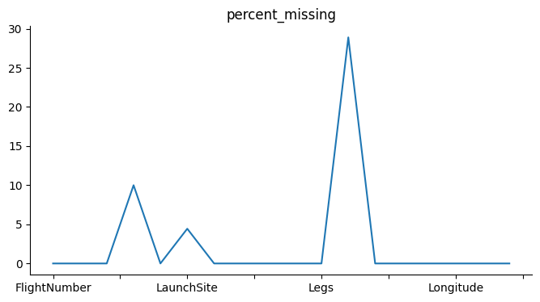
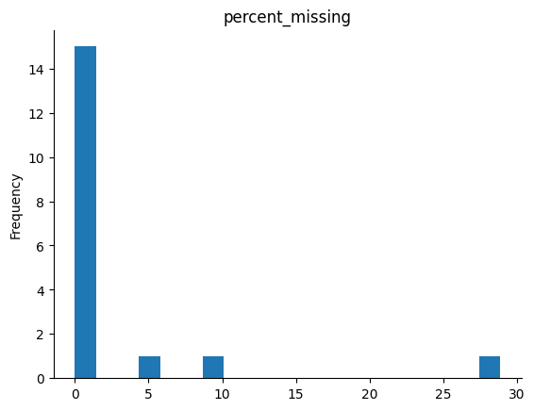
Challenges of Preprocessing

Slide 5
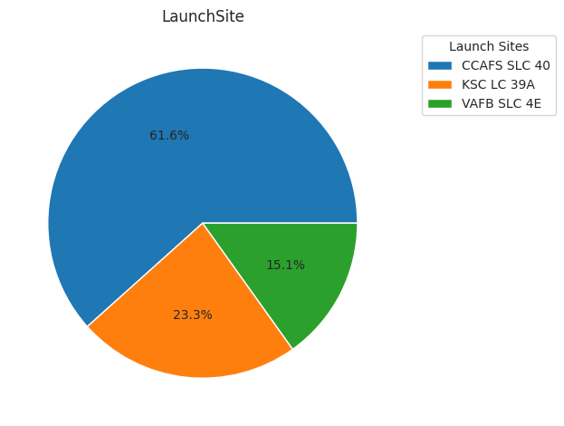
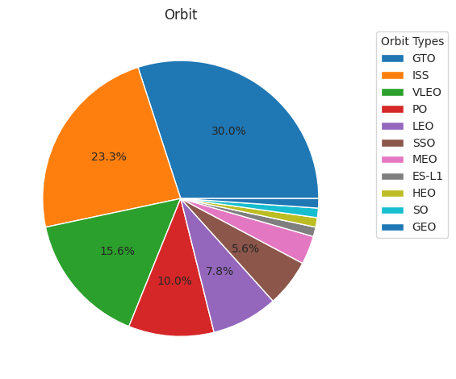
Preprocessing Method
Chi-Square Test for Analyzing Missing Data Relationships
Chi-Square Test is a statistical tool used to examine the relationship between missing data and other categorical features.
It helps determine if the missing data is dependent on specific features.
The test is performed by creating a contingency table, which shows how data is distributed across different groups.

Slide 6
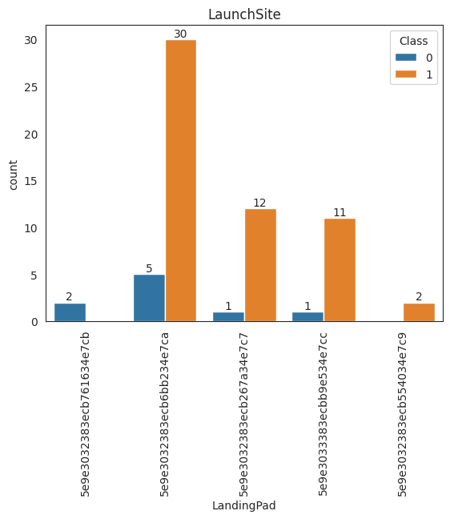
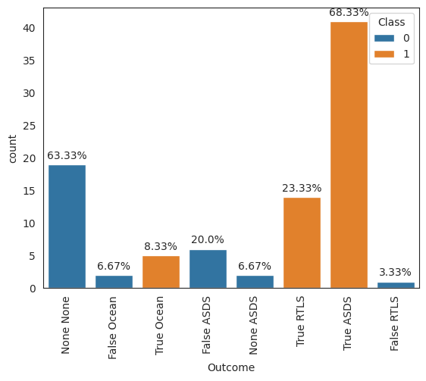
Preprocessing Method

Slide 7
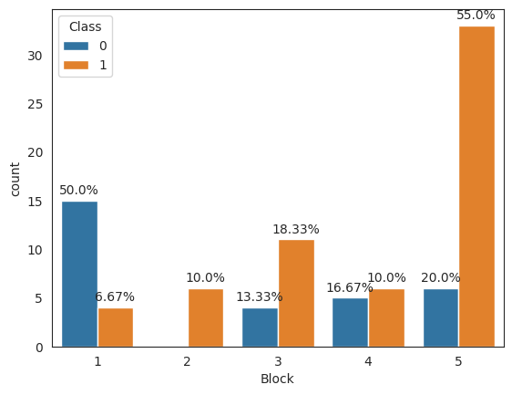
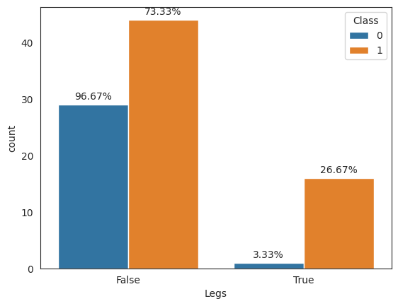
Preprocessing Method

Slide 8
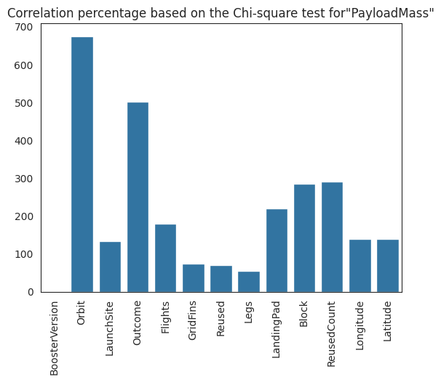
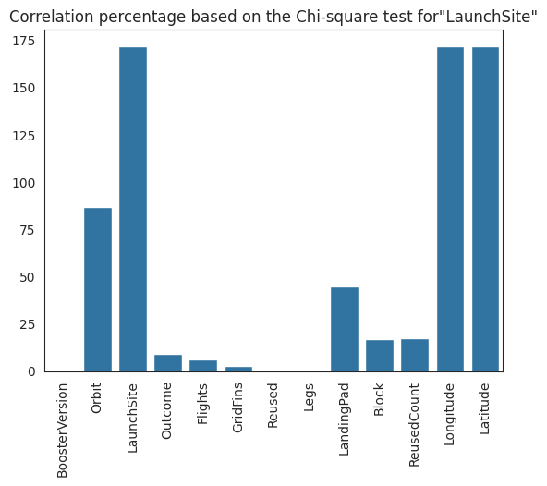
Preprocessing Method

Slide 9
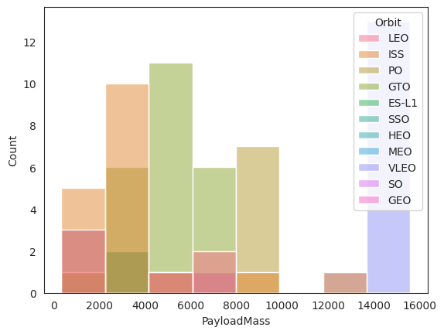
Preprocessing
Filling Missing “PayloadMass” Data Using the Weighted Average for Each Orbit

Slide 10
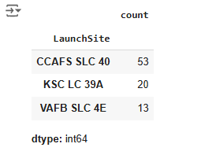
Preprocessing
Filling Missing "LaunchSite" Data by Replacing with the Most Frequent Value
Filling Missing "LandingPad" Data by Considering It as a New Category for Unknown Values Using Fuzzy Logic
Filling Missing payloadMass weight values, they are replaced with the weighted average of the corresponding orbit in which the Falcon rocket is deployed

Slide 11
Preprocessing
Drop these columns:
FlightNumber
Date
BoosterVersion
Longitude
Latitude
Converting Categorical Data into Numerical Using Dummy Variables

Slide 12
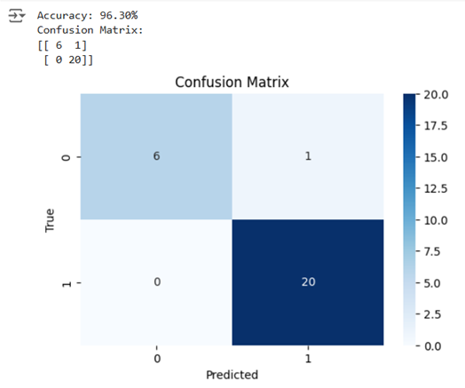
Modeling
Feature and Target Split
Target = “Class” column
Data Standardizationn
Train-Test Split
Model Selection and Training
Model Evaluation

Slide 13
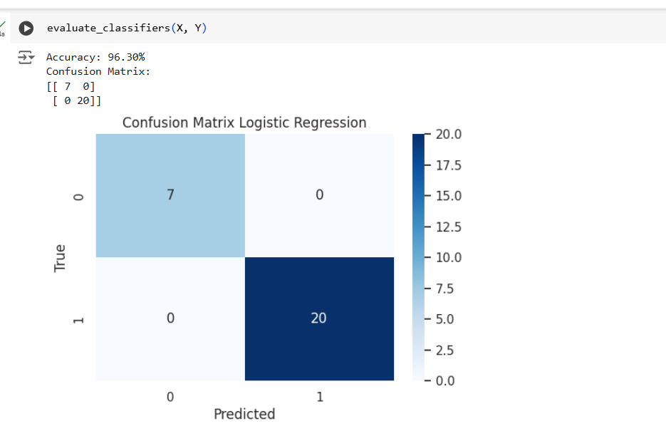
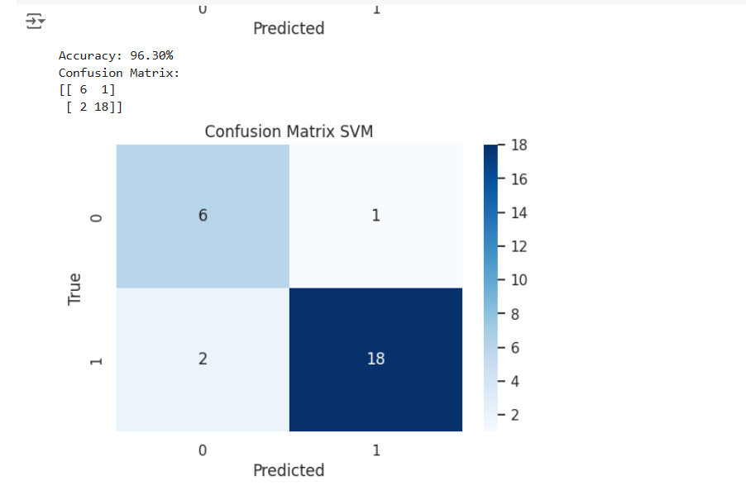
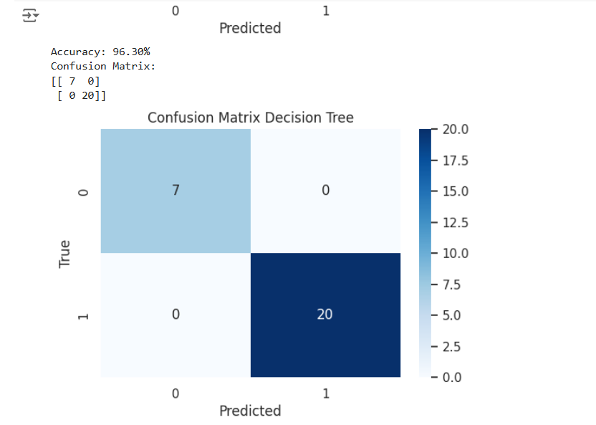
Results

Slide 14
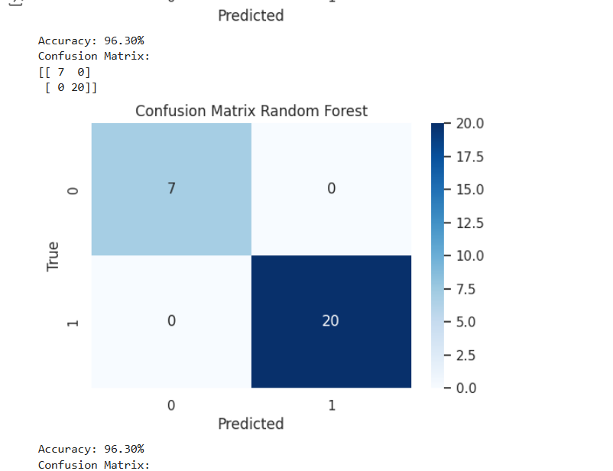
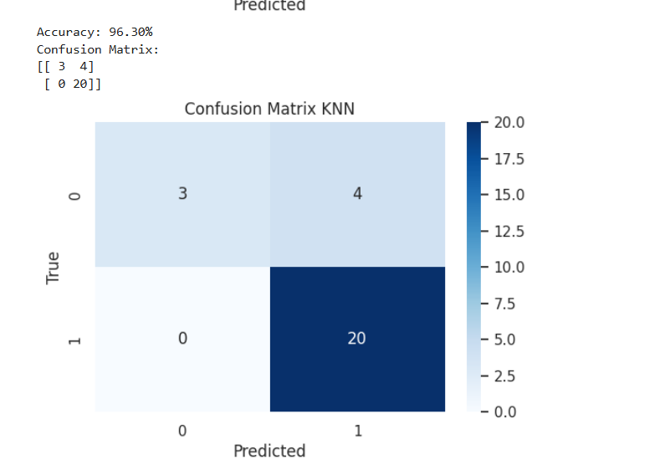
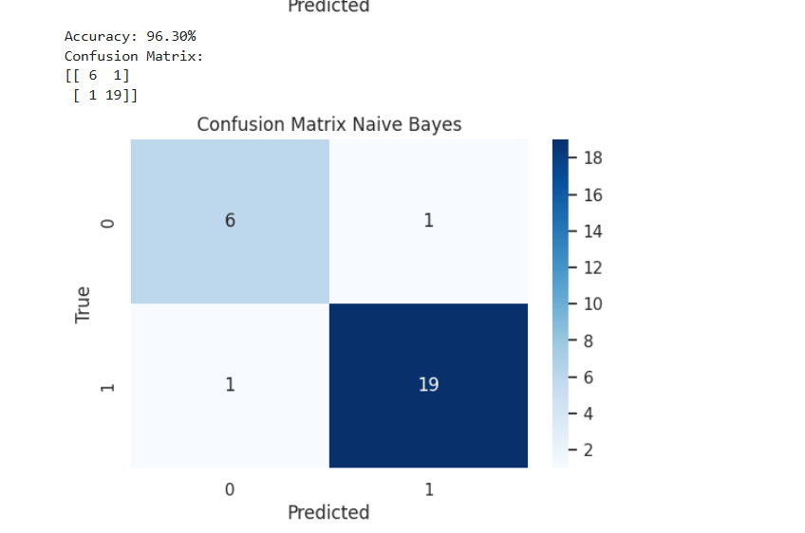
Results

Slide 15
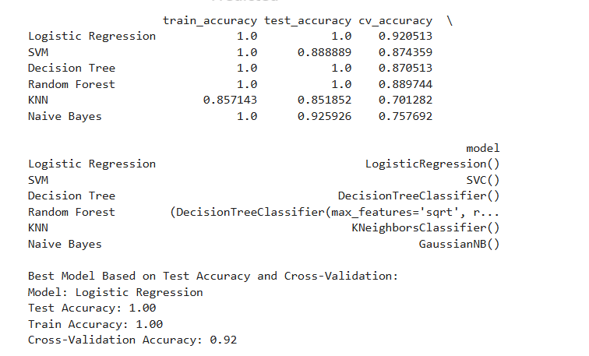
Results
The analysis of the results was conducted using cross validation methods and the Monte Carlo approach.

Slide 16
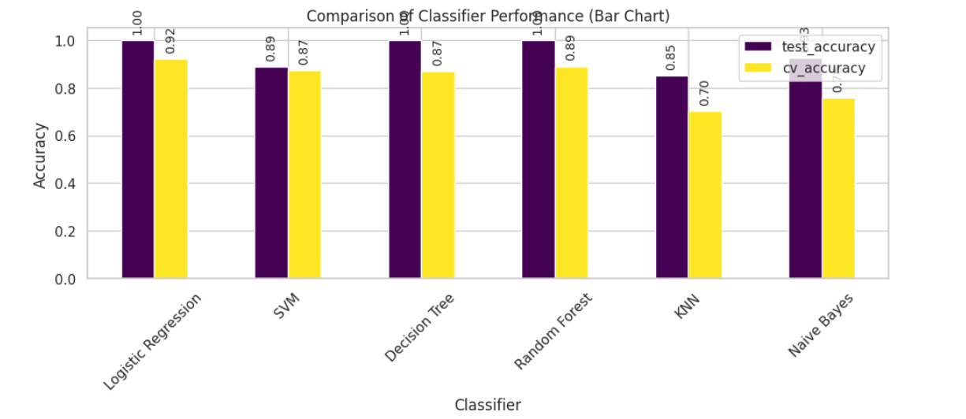
Results

Slide 17
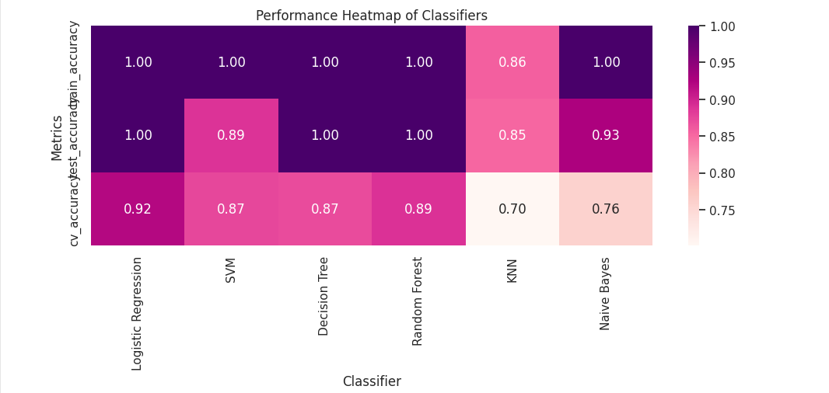
Results

Slide 18
Proposed Solutions🎯
Improving data preprocessing and feature engineering.
Using ensemble methods and hyperparameter tuning to optimize models.
Enhancing evaluation with diverse metrics and error analysis.
Optimizing model deployment through APIs and efficient storage.
Presenting results via interactive visualization to facilitate employer decision-making.

Slide 19
THE END

